Slide 1

L5X Automation Build Tool
Creating an alternative tool for generating L5X files for use in Rockwell Automation’s Studio 5000 Logix Designer

Slide 2
Outline
Project Necessity
Requirements
Design Timeline
System Architecture
Core Classes
Major Code Refactor
Sequence Visualization
Application Demo
Testing & Verification
Lessons Learned
Conclusions

Slide 3
Project Necessity
The goal of this application was to create a tool that can function as an alternative to Rockwell Automation’s Studio 5000 Logix Designer.
It needed to address the following issues with the existing designer:
The existing designer was designed for high-detail PLC (programmable logic controller) code development
Designing controller code from scratch for each project in the designer could be tedious and repetitive
No simple way to generate large amounts of basic template code quickly
Feature enabling the creation of a tool:
The designer can import/export custom XML files(.L5X) containing automation code in segments or in full
Notes:
is Rockwell Automation’s main engineering and programming environment for controllers.
It provides a single, scalable platform to configure, program, and maintain control systems within Rockwell’s Integrated Architecture. The software supports multiple programming languages—Ladder, Structured Text, Function Block, and Sequential Function Chart—within one unified design environment.
Engineers use it to build I/O configurations, manage tags, develop logic routines, and integrate Rockwell hardware.

Slide 4
Requirements
It will help augment rapid PLC code development through implementation of the following features:
Create new objects from a default template
Import objects from other files
Modify existing objects in the file
Delete existing objects in the file
Load existing files
Save file as .L5X
Library of files for the user to select from – only partially implemented
Notes:
These operations are the core of what the application needs to do.
Modeled after CRUD operations for storage operation, as the application treats the L5X files almost like a database
Template library is partially implemented—architecture supports it, but library was not fully populated

Slide 5
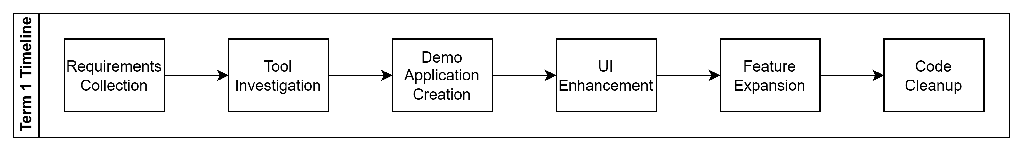
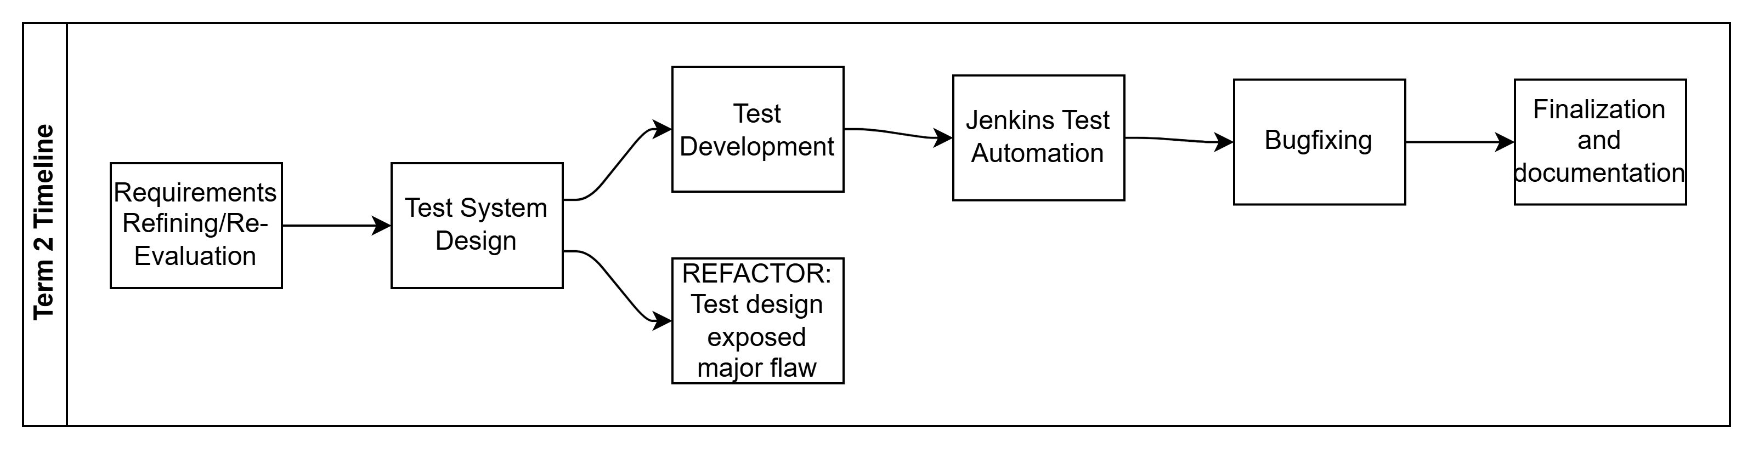
Design Timeline
Notes:
Term 1 focused on application design and development, making the first draft of the demo to ensure a solid baseline.
Term 2 focused on refinements, developing a test suite and automating it, then utilizing that test suite for bugfixing and verification.
Early test development exposed issues with the structure of the application, prompting a refactor. Will go over details in later slide

Slide 6
Tools & Technologies
Development Technologies
C# – Primary programming language for application logic
LINQ to XML – XML parsing, querying, and structured L5X manipulation
Windows Forms – GUI framework for the forms taking user input and presenting information
XSD Schema File –XML file validation reference for L5X content and structure verification
Testing & Quality Assurance
MSTest – Unit testing framework for backend and workflow logic
Moq – Mocking framework used to isolate external dependencies during tests
FlaUI – Automated UI testing to validate GUI window flow
Automation & Project Management
Jenkins – Automated pipeline for continuous testing and verification
Trello – Task tracking, requirements organization, and progress visualization

Slide 7
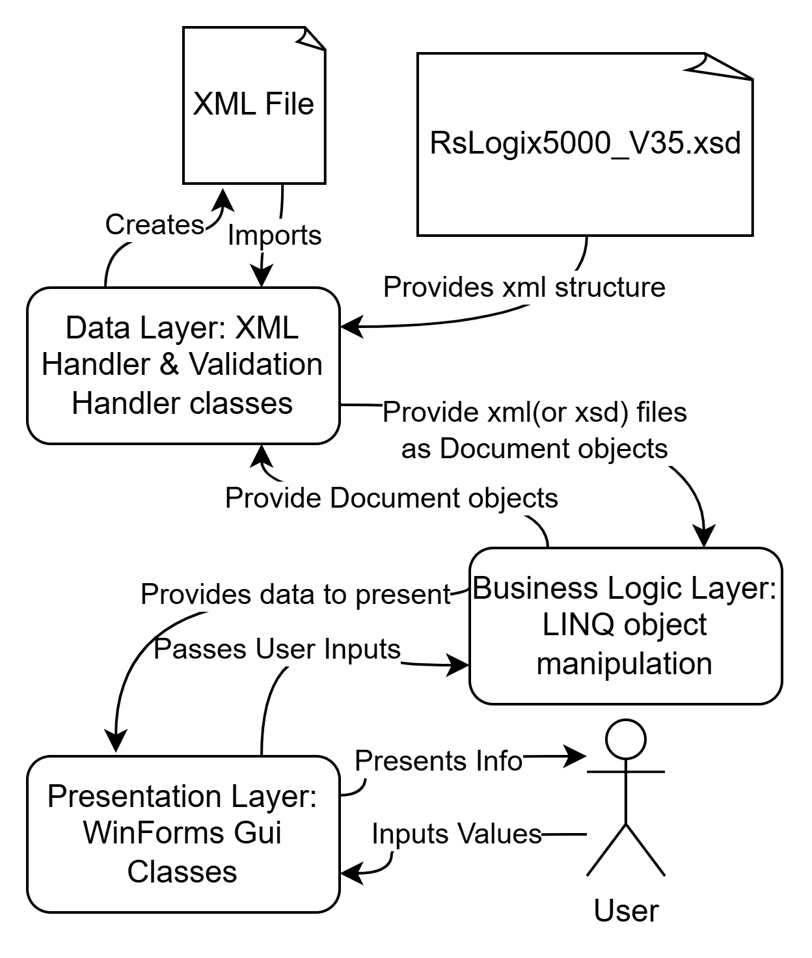
System Architecture
3-Tiered architecture style:
Presentation Layer:
Multi‑form, event‑driven interface
Collects user input and returns structured data
Dynamically navigates between UI stages based on workflow logic
Business Logic Layer:
Core processing written in C# using LINQ to XML
Imports, Creates, modifies, deletes
Data Layer:
Uses the RSLogix5000_V35.xsd XML schema for XML structure guidance
Identify necessary attributes or subelements
Find valid types or parent and child relations
Loads template files from a defined library
Central XMLHandler class abstracts all read/write operations
Notes:
The system was designed as a 3-tiered architecture. However, this design was incidental, and the system was not so much designed from the start with that in mind so much as it grew to reflect that as development went on. A 3 tiered system naturally handles the necessary interactions that the application performs with external elements, while keeping the core logic abstracted away from those external elements.

Slide 8
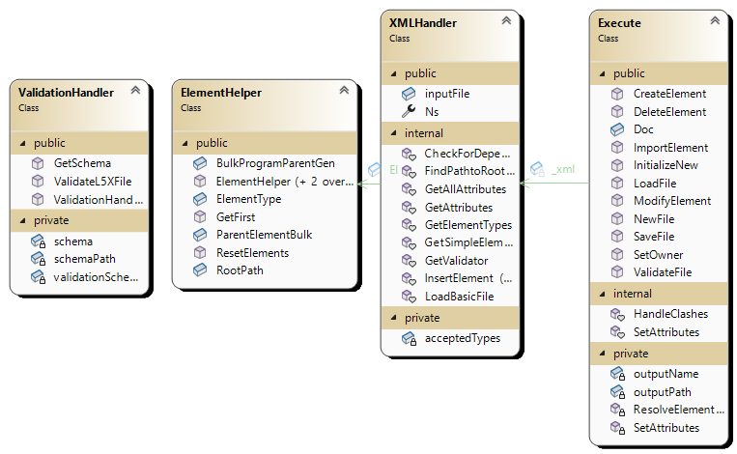
Core Class Functionality-Data & Business Logic Layer
Execute
Orchestrates core functional operations
Only class that interacts with GUI elements (through Interfaces)
ElementHelper
Contains element metadata for the currently active operation
XMLHandler
Handles the reading and writing of XML objects
ValidationHandler
Handles reading of XSD file, passes information to XMLHandler

Slide 9
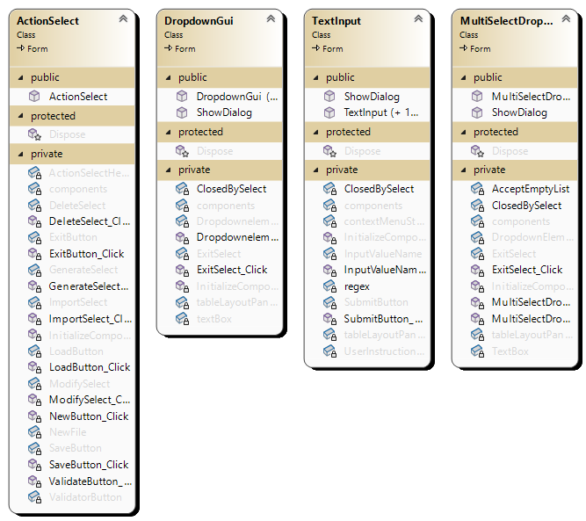
Core Class Functionality – Presentation Layer
ActionSelect
Main menu class, takes button input events and calls functions in Execute class
DropdownGui
Single element selector via a dropdown
Called when user must select between a defined list of options
MultiSelectDropdown
Multiple element selector via a dropdown
Called when user must select between a defined list of options
TextInput
Text input field for user to type in text
Utilizes regular expression for input validation

Slide 10
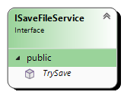
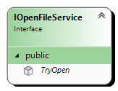
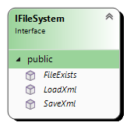
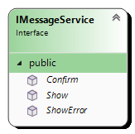
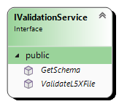
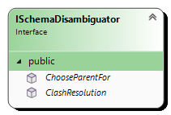
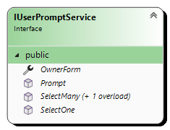
Major Code Refactor
Refactored application to implement interface handling
Interfaces were needed for testability and isolating any interaction with external elements
Made file structure much smoother with clear rules: only Execute class calls the user interaction interfaces, only XMLHandler calls IschemaDisambiguator
Added 7 interface classes for any interactions with external elements
User interactions:
IOpenFileService
ISaveFileService
IMessageService
IUserPromptService
File Interactions
IValidationService
IFileSystem
ISchemaDisambiguator
Notes:
Early design had tightly coupled UI and Logic
Started because automated testing tools required interfaces to implement unit tests

Slide 11
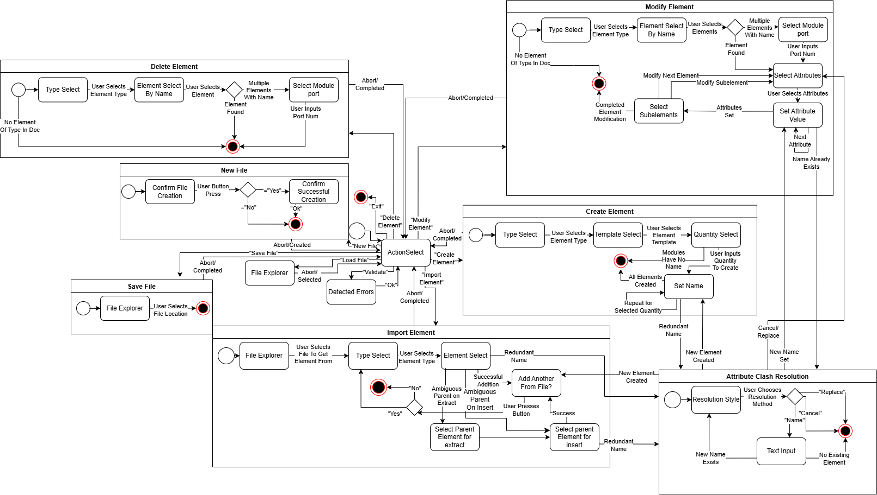
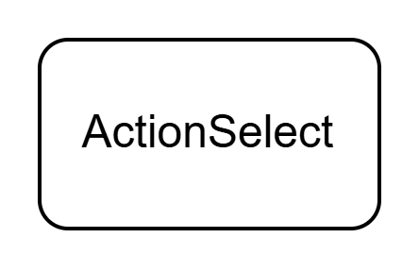
GUI Displays Flowchart
Notes:
This is the entire flowchart for all user interactions in the application. However, due to the complexity we will focus on one sequence(New File).
We start with the “Main menu” that is the action select window.

Slide 12
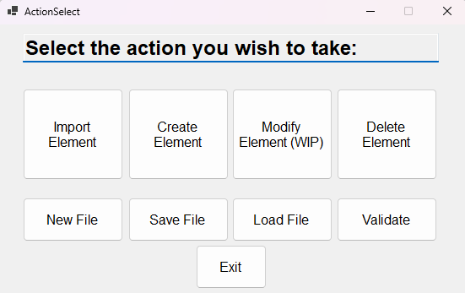
GUI Displays Flowchart
Notes:
The action select window presents the user with all the options that they can take, each press follows a sequence as seen in the initial GUI flowchart. We will follow the new file sequence, to overwrite the existing file being loaded, and create a new blank file. Because of templating, the default(and new) file is not a blank xml but instead a template of a file with no elements.

Slide 13
New File Pathing
Notes:
Shown in the GUI diagram below is the specific segment the code is currently waiting on, it will stay here until a user button press, and either move to a confirmation popup, or abort the sequence and return to the Action Select window

Slide 14
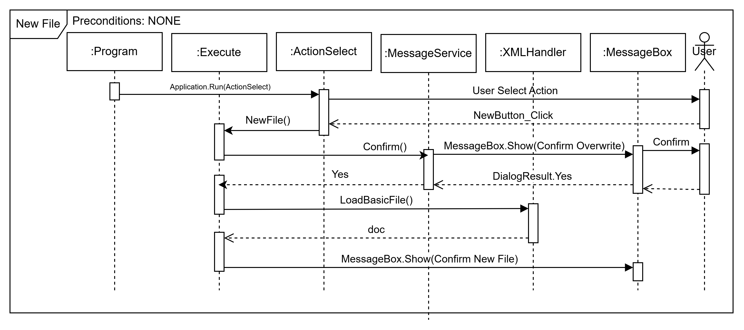
New File Pathing
Notes:
Shown above is the sequence after the user presses the New File button.
Standard to all sequences, when actionSelect detects a button press event, it calls the associated Execute function for that action. That Execute function then handles whatever internal actions it needs to before utilizing the MessageService class to prompt the user for inputs or action clarifications. In the functions that interact with elements this is often a type selection then a specific item selection. It then presents the window that needs the input, and the application waits for the user to press the input.

Slide 15
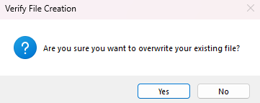
New File Pathing
Notes:
This is the window that the user sees. It is a default MessageBox popup that is windows controls, created with the default Forms class

Slide 16
New File Pathing

Slide 17
New File Pathing
Notes:
Once the user confirms file creation, control returns to Execute

Slide 18
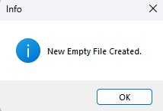
New File Pathing
Notes:
The same as previously shown, a popup appears so that the user knows there was no error during operation, if an error occurs during any point of operation, the same structured window appears with the text replaced with the error message.

Slide 19
Test Structure & Tools
The tests are written in C# utilizing MSTest, and are split into 3 different namespaces:
ExecuteTests-48 Tests
Testing functionality for the core element handling sequences
Largest namespace as it tests most major sequences in many configurations and edge cases
Utilizes MOQ to bypass external element access functions
XMLHandlerTests-16 Tests
Testing backend supporting helper functions
Verifying backend logic
Utilizes MOQ to bypass external element access functions
GuiTesting-14 Tests
Verifying the window sequence chart
Utilizes FLAUI to automate gui window testing
Notes:
Within Execute: Create, delete, handle clashes, Import, load file, modify, new, save, set attributes, validate
Three‑tier testing mirrors the layered architecture: Component tests for XML manipulation. Workflow tests for operation sequences. UI automation for interaction flow.

Slide 20
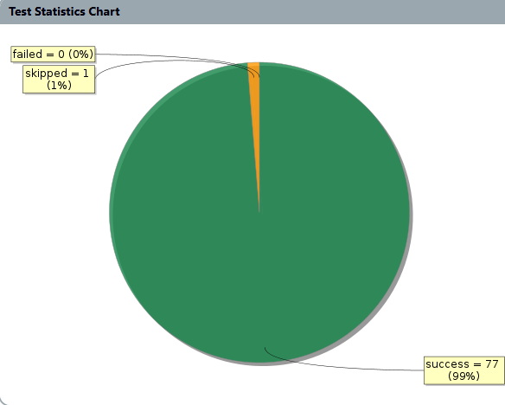
Test Results
Tests were run both locally and on Jenkins pipeline
High passing test rate indicates stable architecture
Skipped test: RedundantModifyElement
Covers the edge case of modifying an element to clash with an existing element
Skipped as that handling was not implemented at project finish
Kept for notation purposes and potential future implementation

Slide 21
Application Demo
Live Demo!

Slide 22
Lessons Learned
Start with clearly defined and detailed requirements
Segment out and abstract classes from the start, interfaces were very helpful
Devote more time to comparing tool options early on, rather than running with the first tool that works
Integrate documentation work throughout development, rather than separately
Develop tests alongside application, not after the fact(test-driven development leads to cleaner code and easier debugging)
Keep a constant line of communication open with the client(Matt) for better workflow in system design

Slide 23
Conclusion
Gained substantial experience in software design principles, test‑driven development practices, UML modeling, and project management techniques for single‑developer projects
Potential future additions:
Upgraded UI to more intuitive feel
Enhanced system validation
Opening file being actively modified
Significant additional input and item‑level validation is required to ensure data integrity and make the tool viable for real‑world deployment
Still requires extensive manual corrections outside of the defined XML schema, reducing reliability and increasing error risk
Not all dependencies function like normal XML dependencies but are unique to L5X, meaning they cannot be included in the schema

Slide 25
Resources
RSLogix5000_V35.xsd
https://literature.rockwellautomation.com/idc/groups/literature/documents/pm/1756-pm019_-en-p.pdf
https://literature.rockwellautomation.com/idc/groups/literature/documents/rm/1756-rm014_-en-p.pdf
System.Xml.Linq Namespace | Microsoft Learn
devlooped/moq: The most popular and friendly mocking framework for .NET
FlaUI/FlaUI: UI automation library for .Net
MSTest overview - .NET | Microsoft Learn

